Slide 1

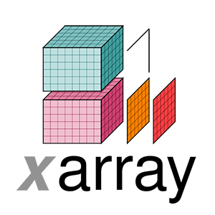
SpatioTemporal Asset Catalogs & Xarrays
Steve Firsake

Slide 2
Objectives
What is STAC?
Search public STAC repositories of satellite imagery using Python.
STAC search result metadata inspection.
Raster calculations with Rioxarray on STAC Items

Slide 3
What is STAC?
A standardized format for describing geospatial data that makes it easier to discover/search, access (interoperable), and analyze.
A SpatioTemporal Asset is any file that represents information about the Earth captured in a certain place and at a particular time.
Core Components:
STAC Item - GeoJSON describing a SpatioTemporal Asset(s) e.g. a Sentinel-2 scene
STAC Catalog - A JSON file with links to other catalogs, collections or items e.g. Sentinel-2 Image Collection
STAC Collection - Contains links to catalogs and further metadata about them e.g. ESA data series
Resource Link

Slide 4
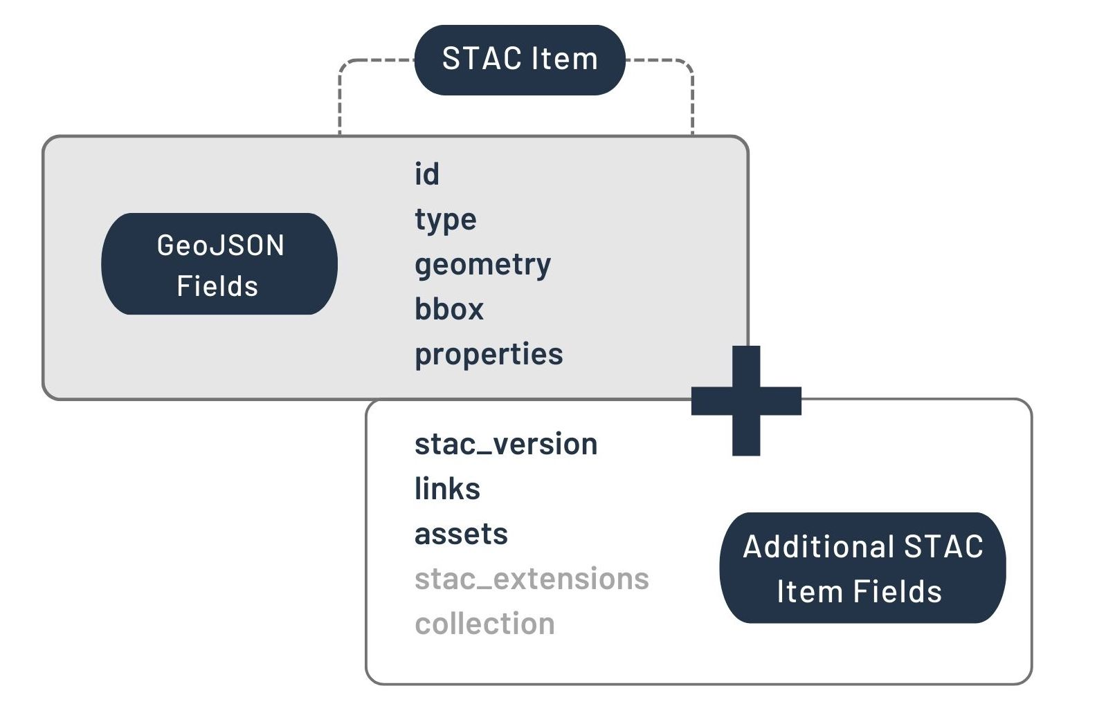
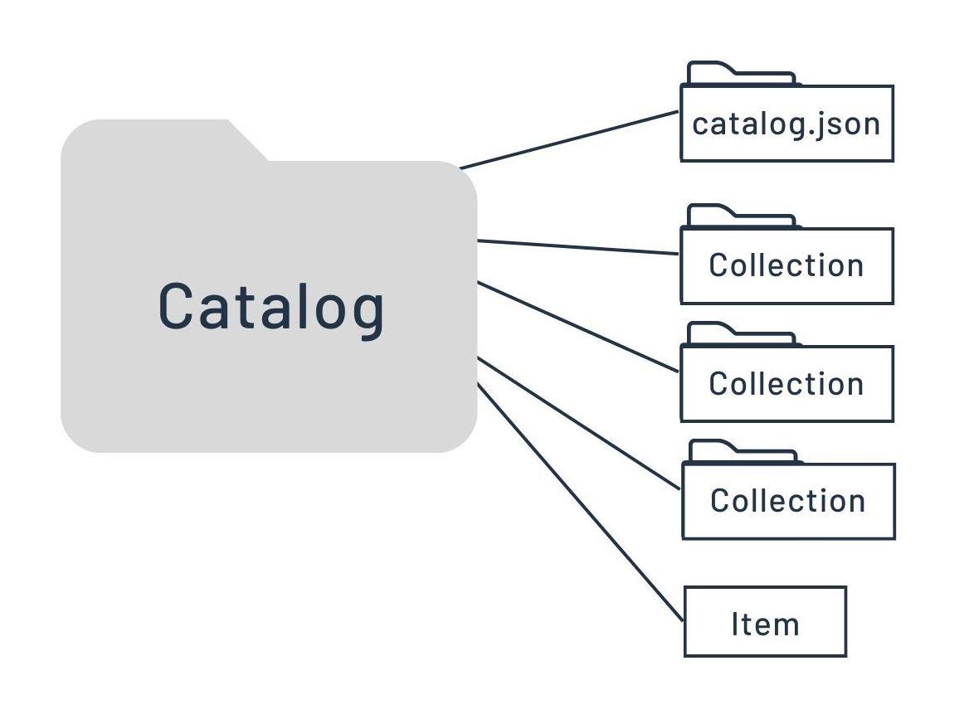
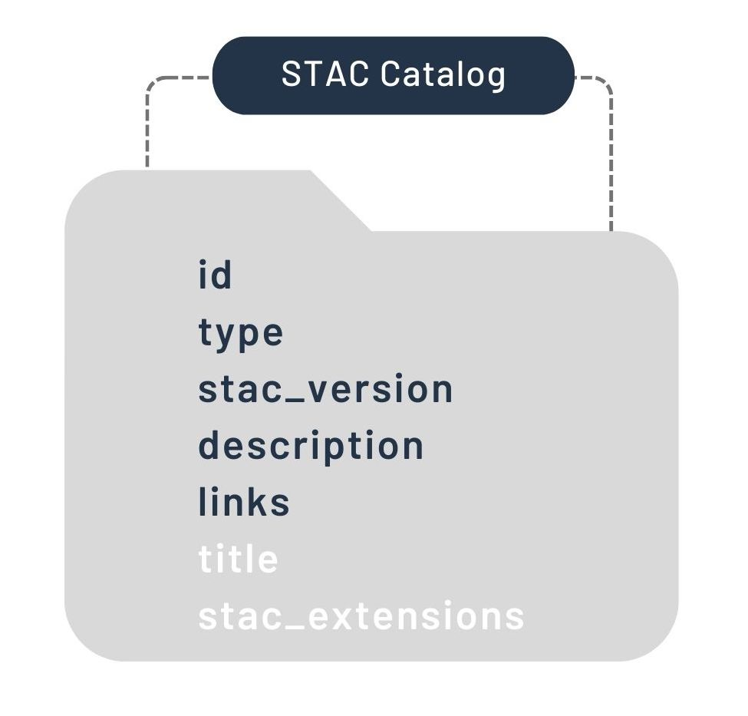
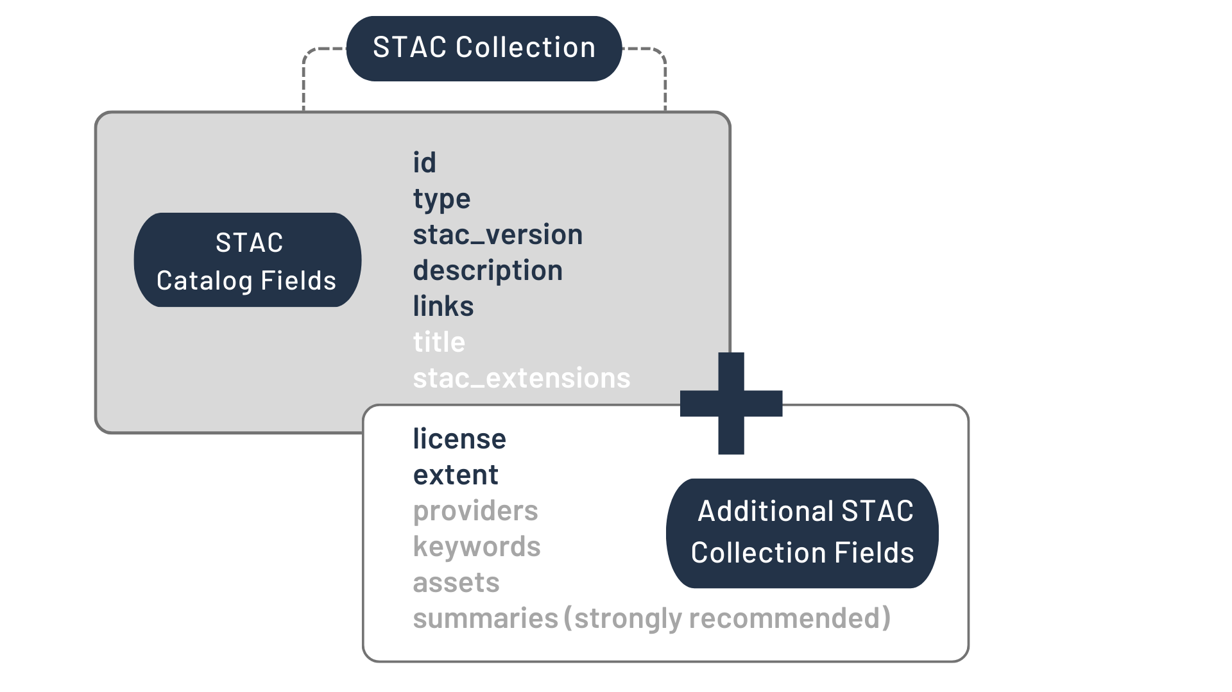
What is STAC?
Top Left: STAC Item
Bottom Left: STAC Collection
Right: STAC Catalog
Resource Link

Slide 5
Public STAC Catalogs
Different data providers have adopted the use of STAC and provide APIs for access.
They can be accessed through Radiant Earth STAC Browser or through the stacspec website.
Users can build their own STAC catalogs through tools like rio-stac or pySTAC and host the catalog via an API framework like FastAPI.
Assignment
Explore the Earth Search (AWS) public collection.
Explore Google Earth Engine (OpenEO) public collection.
In both public APIs can you identify any collection and find a catalog, item, asset and metadata.
Explore this Earth Search browser
Resource Link

Slide 6
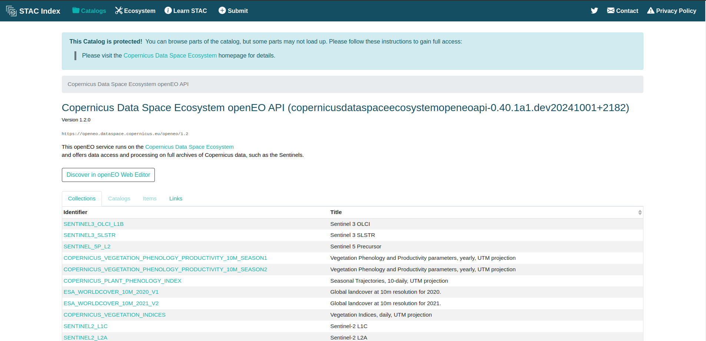
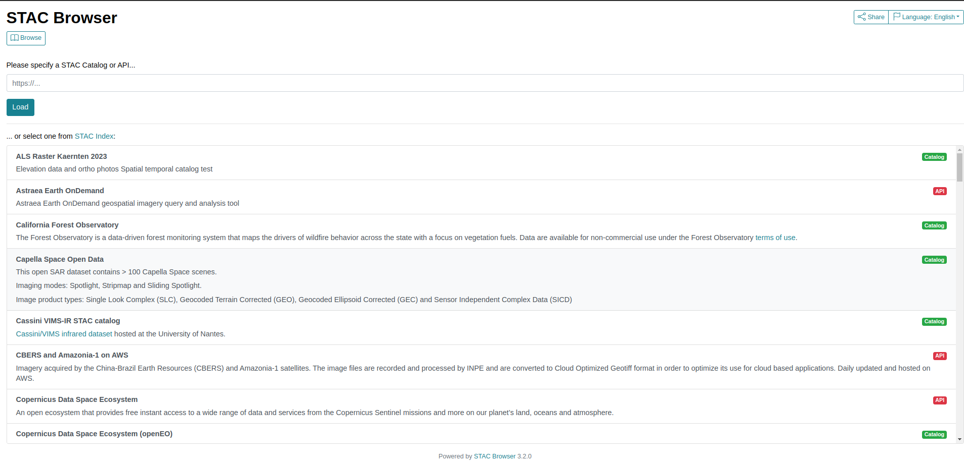
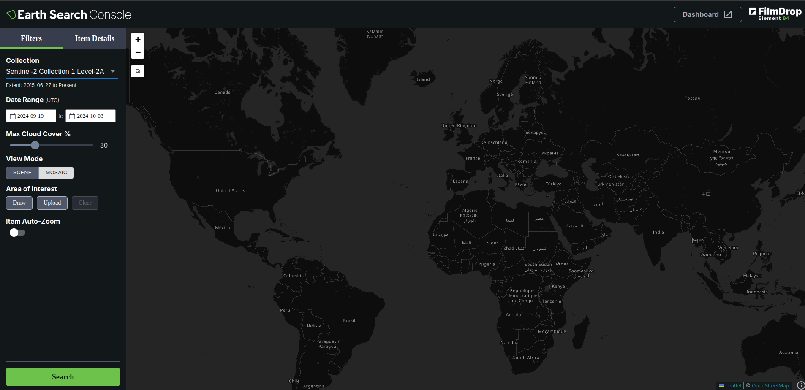
Public STAC Catalogs
Top Left: stacspec browser
Bottom Left: earth search console
Top Right: Radiant browser

Slide 7
Python and Public STAC Catalogs
STAC APIs can be accessed using pystac-client library which is an extension of pySTAC.
You can also use other libraries that load STAC directly into an Xarray but we will look into those later. Examples are rioxarray, stackstac, odc-stac…
For all python assignments kindly use Google Colab, Jupyter Notebook or SageMaker.
Assignment
Install pystac-client.
Find Earth Search (AWS) public API URL.
From link, link, link and link, can you figure out how to load the sentinel-2-l2a collection for any shapely/GeoJSON Point(lon, lat) in your region of interest for the any date range in 2024 (filter cloud cover less than 10%) and get the number of items, and inspect the first item metadata (datetime, geometry and properties) and assets?
Hint: You can use Earth Search browser to see what items should be present. Example on next slide.
Resource Link

Slide 8
Python and Public STAC Catalogs - Solution Notebook
from pystac_client import Client
from shapely.geometry import Point
api_url = "https://earth-search.aws.element84.com/v1"
client = Client.open(api_url)
collection = "sentinel-2-l2a"
point = Point(40.300576712378245, -0.4129712274018118)
search_results = client.search(
collections=[collection],
intersects=point,
datetime=[‘2024-01-15’,’2024-01-31’],
query=["eo:cloud_cover<10"]
)
print(len(list(search_results.items())))
first_search_results_item = list(search_results.items())[0]
print(first_search_results_item.datetime)
print(first_search_results_item.geometry)
print(first_search_results_item.properties)
print(first_search_results_item.assets)

Slide 9
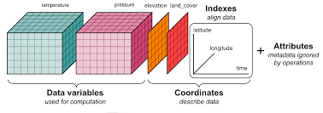
Xarrays
STAC Items can be read using various libraries depending on the framework of analysis that you would like. The best format for dealing with SpatioTemporal assets is Xarrays - a multidimensional data format.
Examples of reading/analysis libraries are rioxarray, stackstac, odc-stac, xarray-spatial, xarray.
Assignment
What is the difference between an xarray.dataset and a xarray.dataArray?
From the links provided, which libraries can read STAC and which ones are for analysis solely?
What is the core difference between stackstac and odc-stac?
Resource Link

Slide 10
Rioxarray - STAC Reading & Computation
We will explore Rioxarray library which extends the Xarray and Rasterio libraries.
Rioxarray.open_rasterio can directly open a pathlike string meaning we can access a STAC Item Asset HREF to load it.
DataArrays have a plot() that can quickly display your image on a Notebook but you can also use matplotlib for the same.
Important: What do you think is the advantage of using stackstac, odc-stac and xarray-spatial over Rioxarray?
Assignment
Proceed with the previous notebook for this assignment.
From any Item of your previous search_result, display it’s thumbnail asset using a library of your choice.
Read the nir and the red assets use masked=True while reading to ignore nodata value.
Inspect the crs, bounds, height and width of the nir and red assets/bands
Do all values match? If not, make sure they are in the same CRS. [optional] Clip bands to a smaller region for faster loading below (Mind the CRS!)
Calculate NDVI and display it.
Get the mean NDVI for your region.
Resource Link

Slide 11
Rioxarray - STAC Reading & Computation - Solution
import rioxarray
from IPython.display import Image
first_search_results_item = list(search_results.items())[0]
thumbnail = first_search_results_item.assets[“thumbnail”].href
Image(thumbnail)
nir_href = first_search_results_item.assets["nir"].href
red_href = first_search_results_item.assets["red"].href
nir = rioxarray.open_rasterio(nir_href, masked=True)
red = rioxarray.open_rasterio(red_href, masked=True)
smaller_roi = (633955.1600,9942611.4293,644961.5136,9951111.4018)
nir = nir.rio.clip_box(*smaller_roi)
red = red.rio.clip_box(*smaller_roi)
print(nir.rio.crs)
print(nir.rio.bounds())
print(nir.rio.width)
print(nir.rio.height)
print(red.rio.crs)
print(red.rio.bounds())
print(red.rio.width)
print(red.rio.height)
ndvi = (nir - red)/ (nir + red)
ndvi.plot(robust=True, cmap=’viridis’) #Test
print(ndvi.mean())

Slide 12
Further Reading
Xarrays
Tutorials
STAC
Tutorials
stackstac vs odc-stac
Benchmark
Rioxarray
Usage Examples
General
Example
Solutions Notebook
Colab notebook
Assignment
For the same tasks - Calculate two indices of choice for the year 2024 to-date for your region of interest. Use odc-stac.
Print the xarray.dataset
Plot using matplotlib the monthly mean for the indices for the year.
Get the annual indices mean, max, median, min, stdDev to-date.
Hint: indexdatabase.de

Slide 13
Thank You
X:@SteveFirsake
LinkedIn: steve-firsake

